Slide 1
Theme: Finding Improvement

Slide 2


Residential Sector Focus

Slide 3
Residential Sector Problem
IN CARS AS CHEAP HOUSES SCARCE
New Zealand has a shortage of over 100,000 homes, industry experts say, but from June 2018 through to July 2020 the government has built or helped build only around 6,000 homes with another 4,000 under construction.

Slide 4
Residential Sector Problem
The problem, according to these experts, is that it costs too much and takes too long to build a house in New Zealand.
Successive governments have failed to ease the red tape around land approval, making land artificially scarce. For private developers the costs and consent process are significant hurdles, making properties unaffordable.

Slide 5
Residential Sector Problem
The coronavirus has worsened conditions, as fewer new houses are being built even as more kiwis return home, while historically low mortgage rates have supercharged demand.
The housing pressures are most keenly felt by those already on the margins, with tens of thousands living in over-crowded homes, in emergency shelters, in cars and on the streets.

Slide 6
Residential Sector Problem
All of the economic stimulus that has been provided this year, much of it "either directed at, or found its way into, the housing market" has "simply exacerbated" the position of excess demand and the tightness of the market that is now evident…
"In short, there’s a scramble for houses."
ASB economists have "materially upgraded" their house price forecasts.
They now expect annual house price inflation of 9% by year end, and "have flipped the small negative we had in for June 2021" to an 11% positive annual increase.

Slide 7
Residential Sector Problem
Median US House Price US$226,800 (Zillow)
Median NZ House Price NZ$685,000 (REINZ)

Slide 8
Residential Sector Problem
Median US House Price US$226,800 (Zillow) – 3.3 x Household Income
Median NZ House Price NZ$685,000 (REINZ) – 6.7x Household Income

Slide 9
Residential Sector Solutions
How can NZ half the cost of Housing?

Slide 10
Residential Sector Solutions
Cheaper Land
Infrastructure Investment
Cheaper Houses

Slide 11
Residential Sector Focus

Slide 12
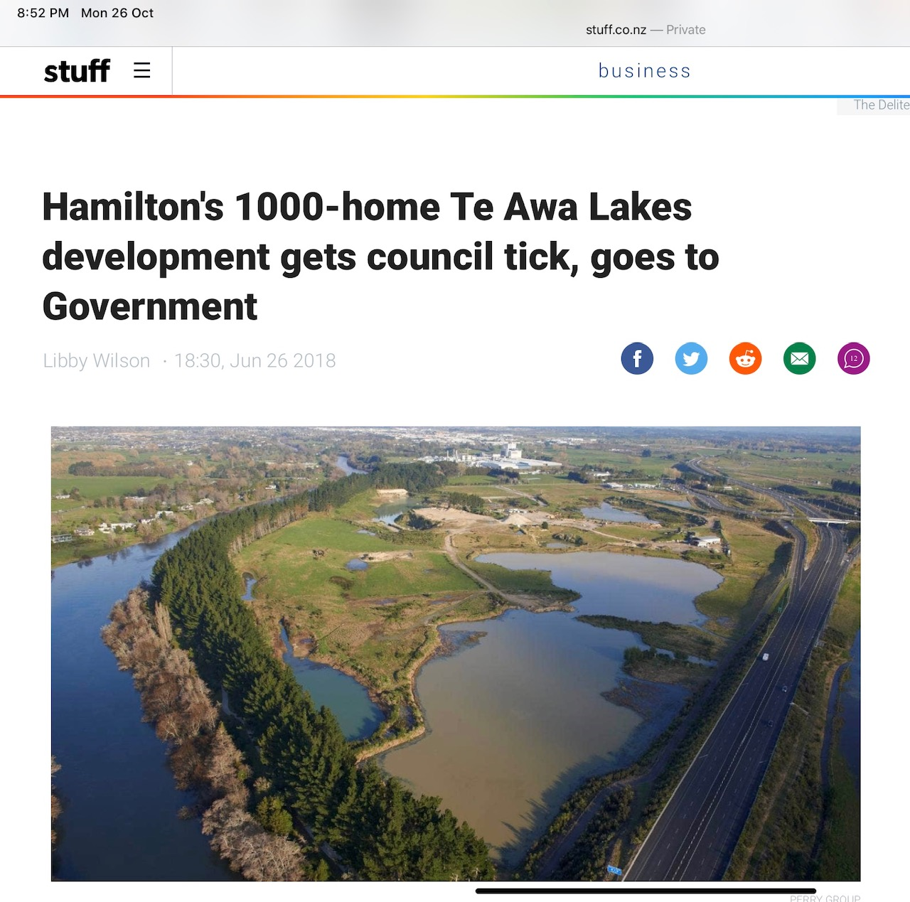

Slide 13
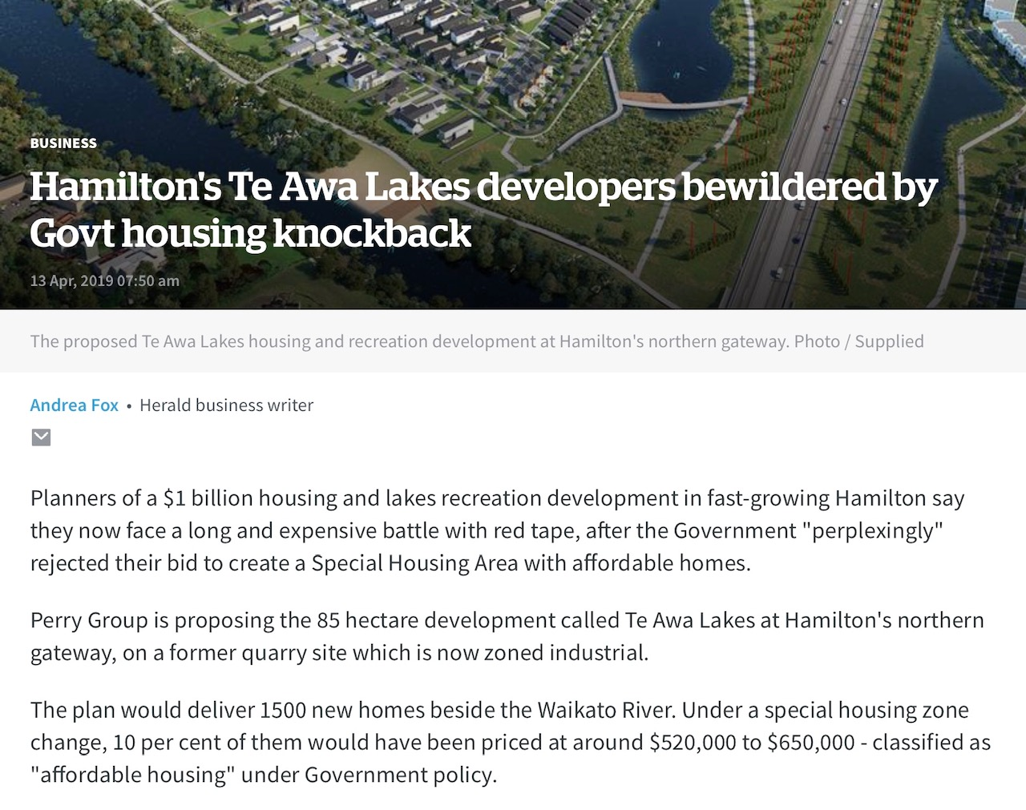

Slide 14
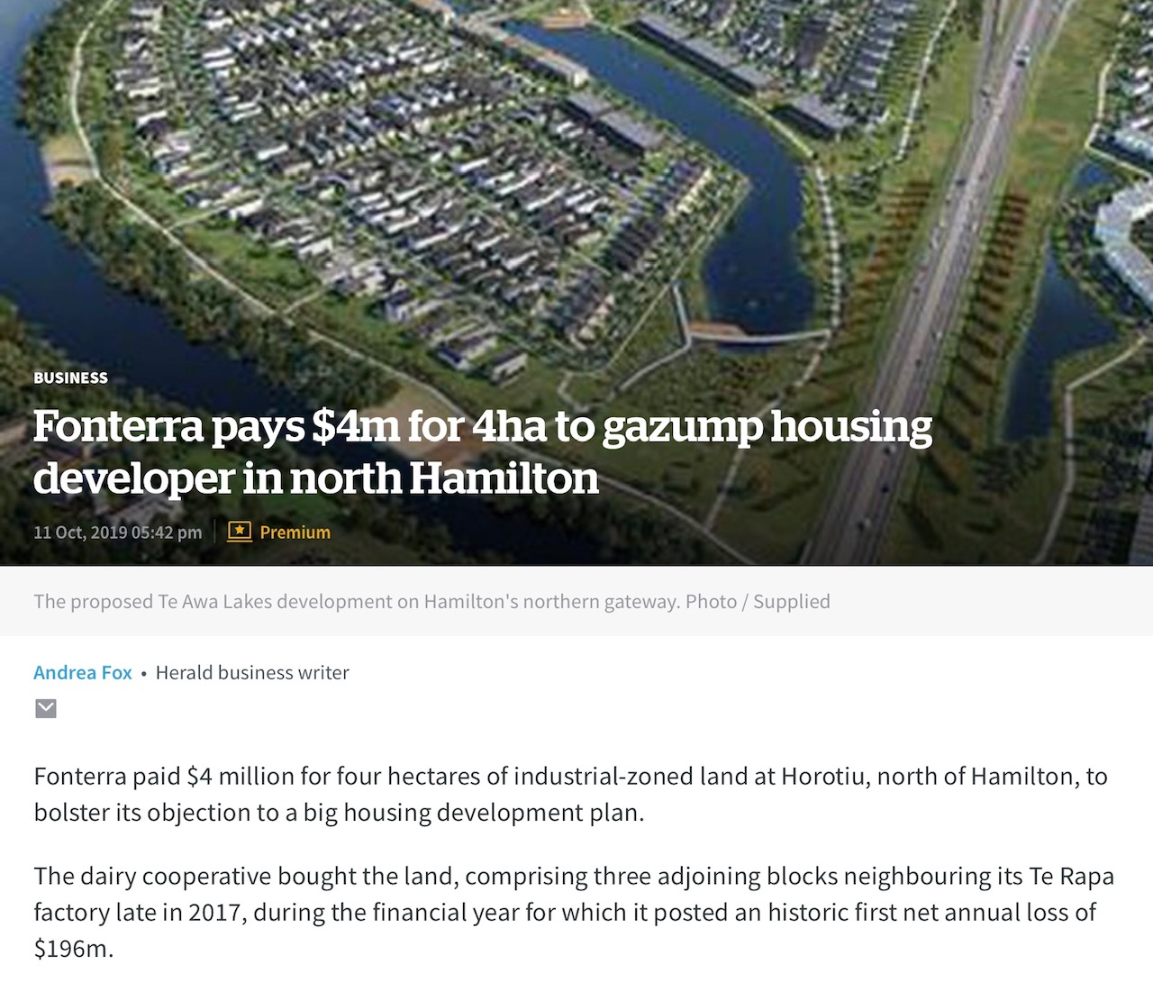

Slide 15
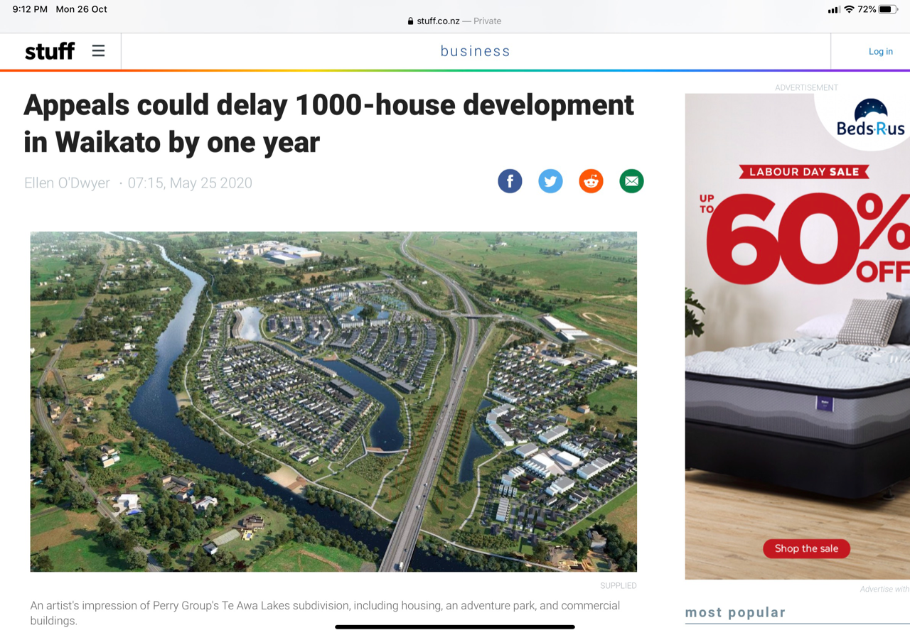

Slide 16
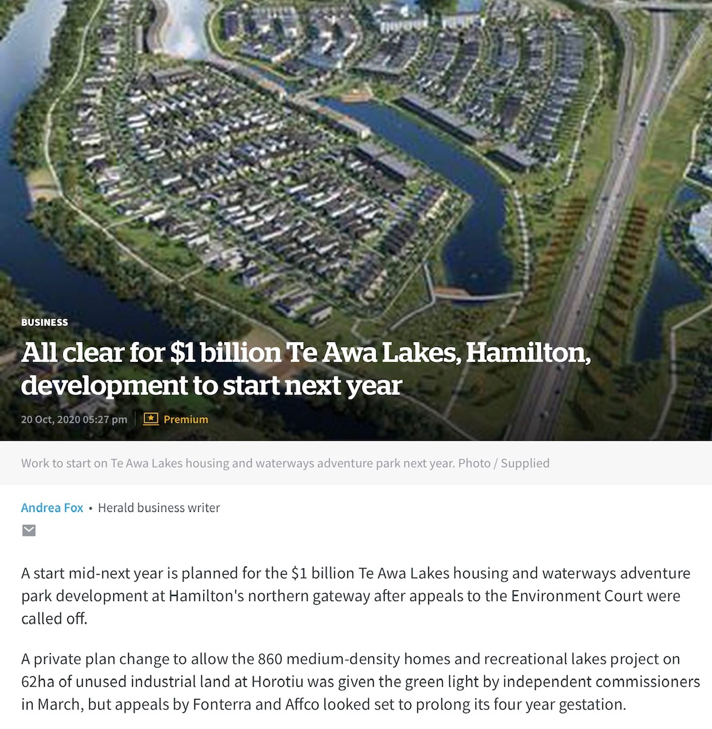

Slide 17


Slide 18


Slide 19
Residential Sector Solutions
Cheaper Land – local authorities should be encouraged and equipped to enable more zoned land availability

Slide 20
Residential Sector Solutions
Infrastructure Investment – local authorities should be funded via Government to enable more 3 Waters infrastructure, roading and amenities

Slide 21
Residential Sector Solutions
Cheaper Housing – NZ needs more builders at scale, off-site manufacturing should be encouraged

Slide 22

Residential Sector Solutions

Slide 23
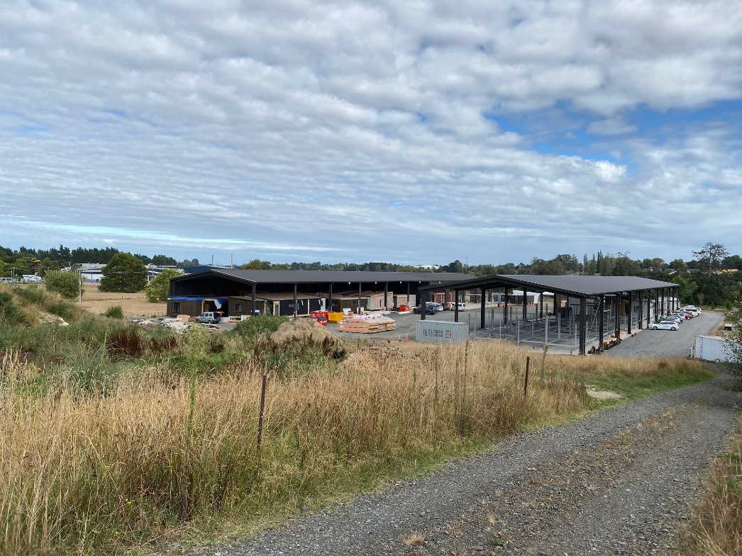
Residential Sector Solutions

Slide 24
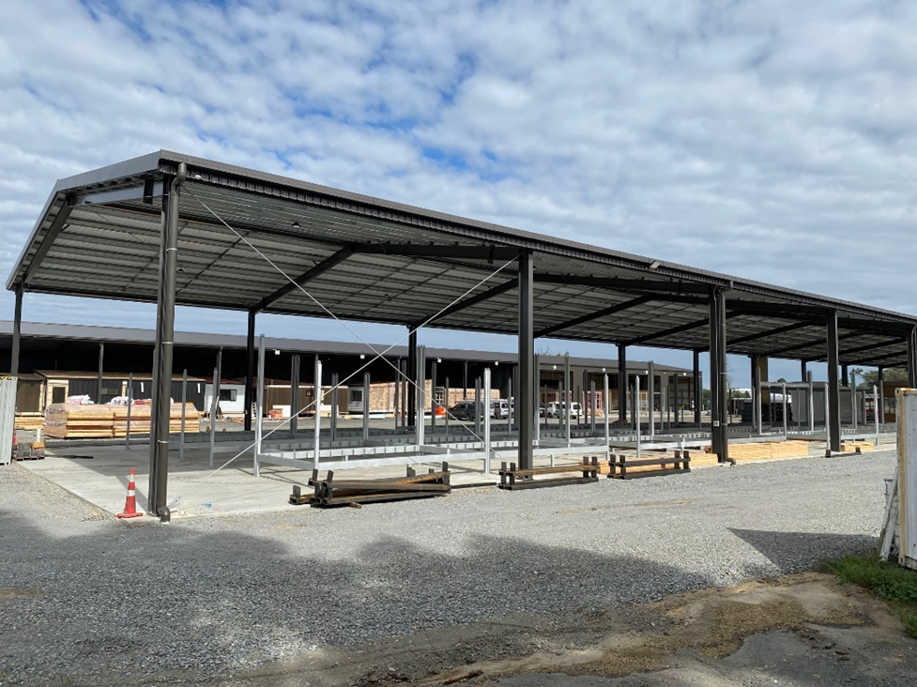
Residential Sector Solutions

Slide 25
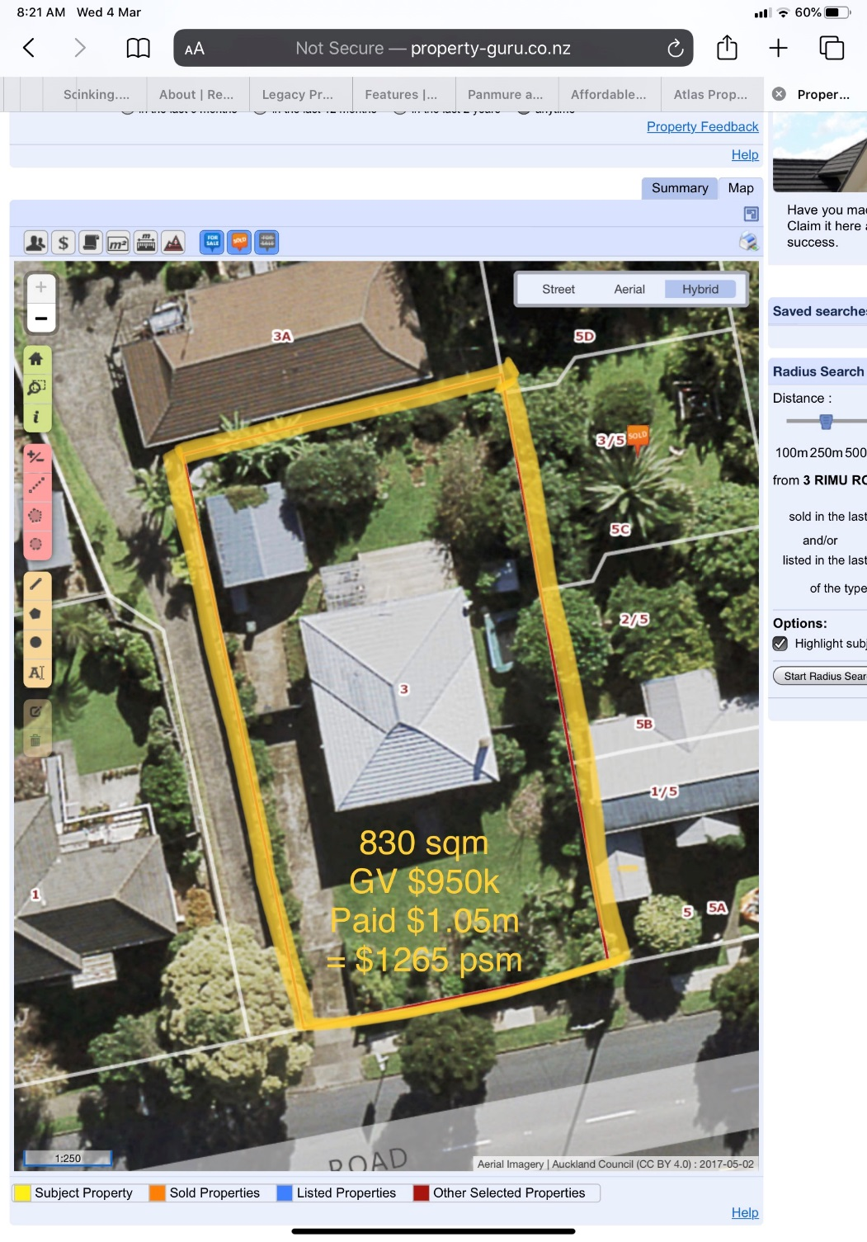
Residential Sector Solutions

Slide 26
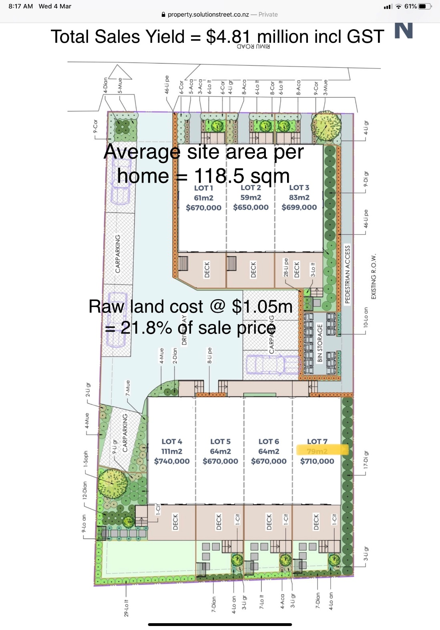

Residential Sector Solutions

Slide 27
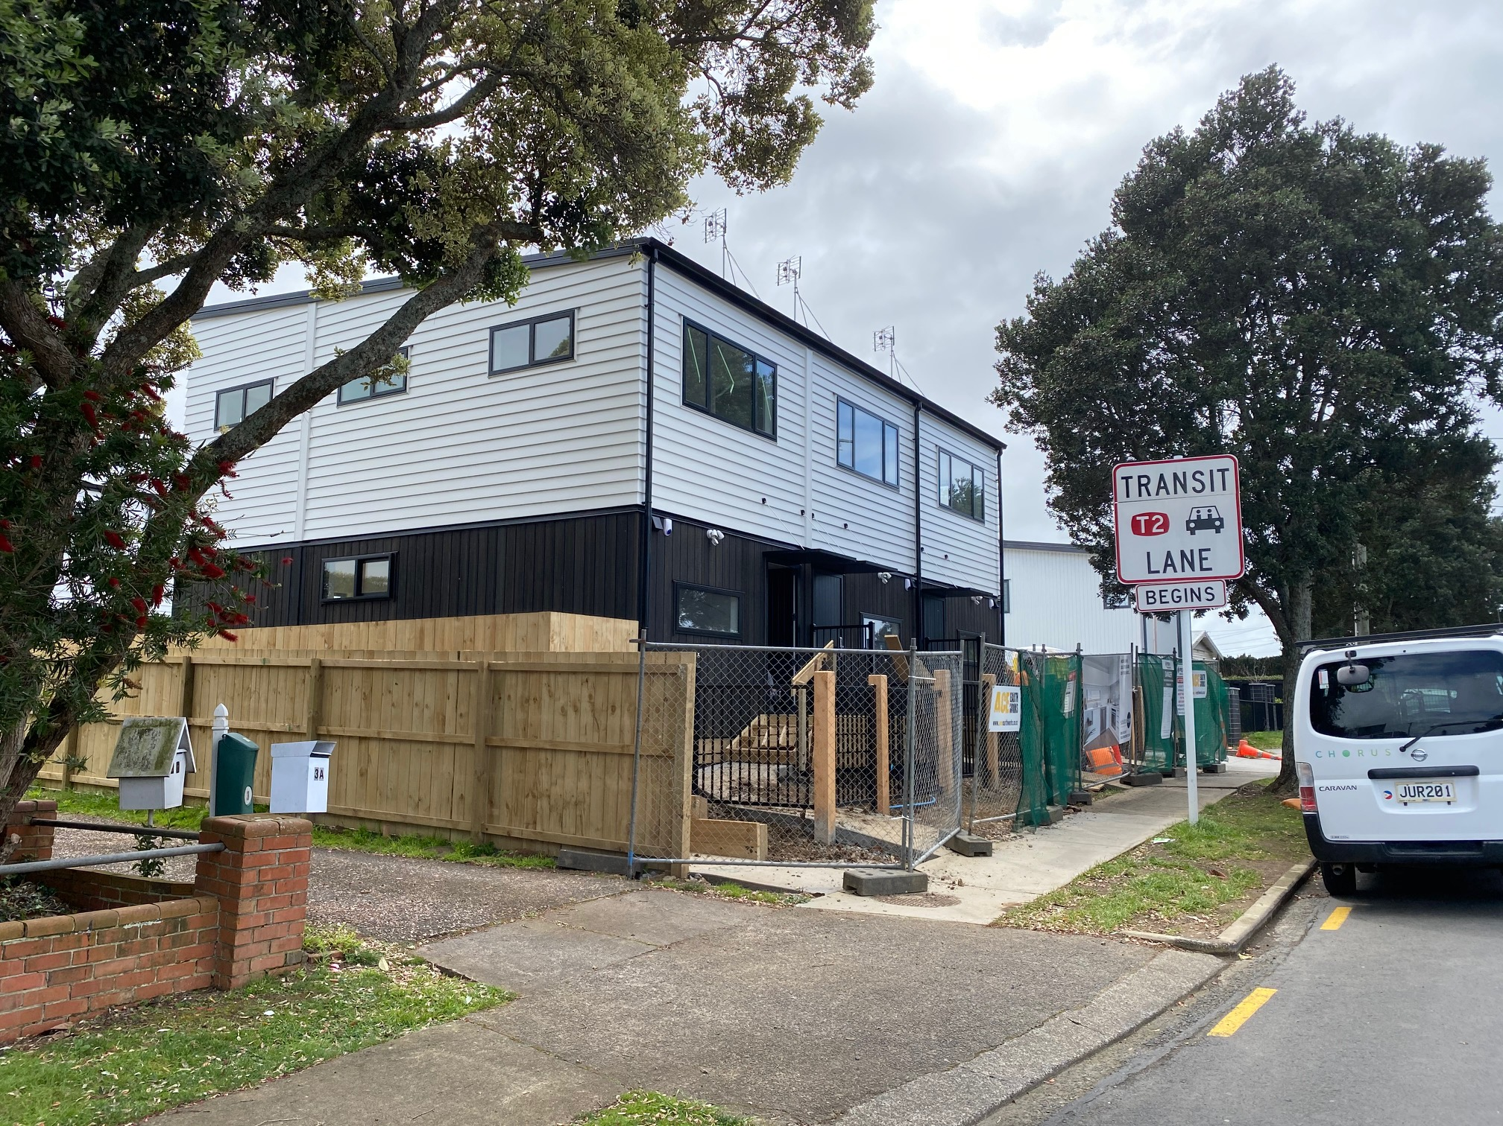
Residential Sector Solutions

Slide 28
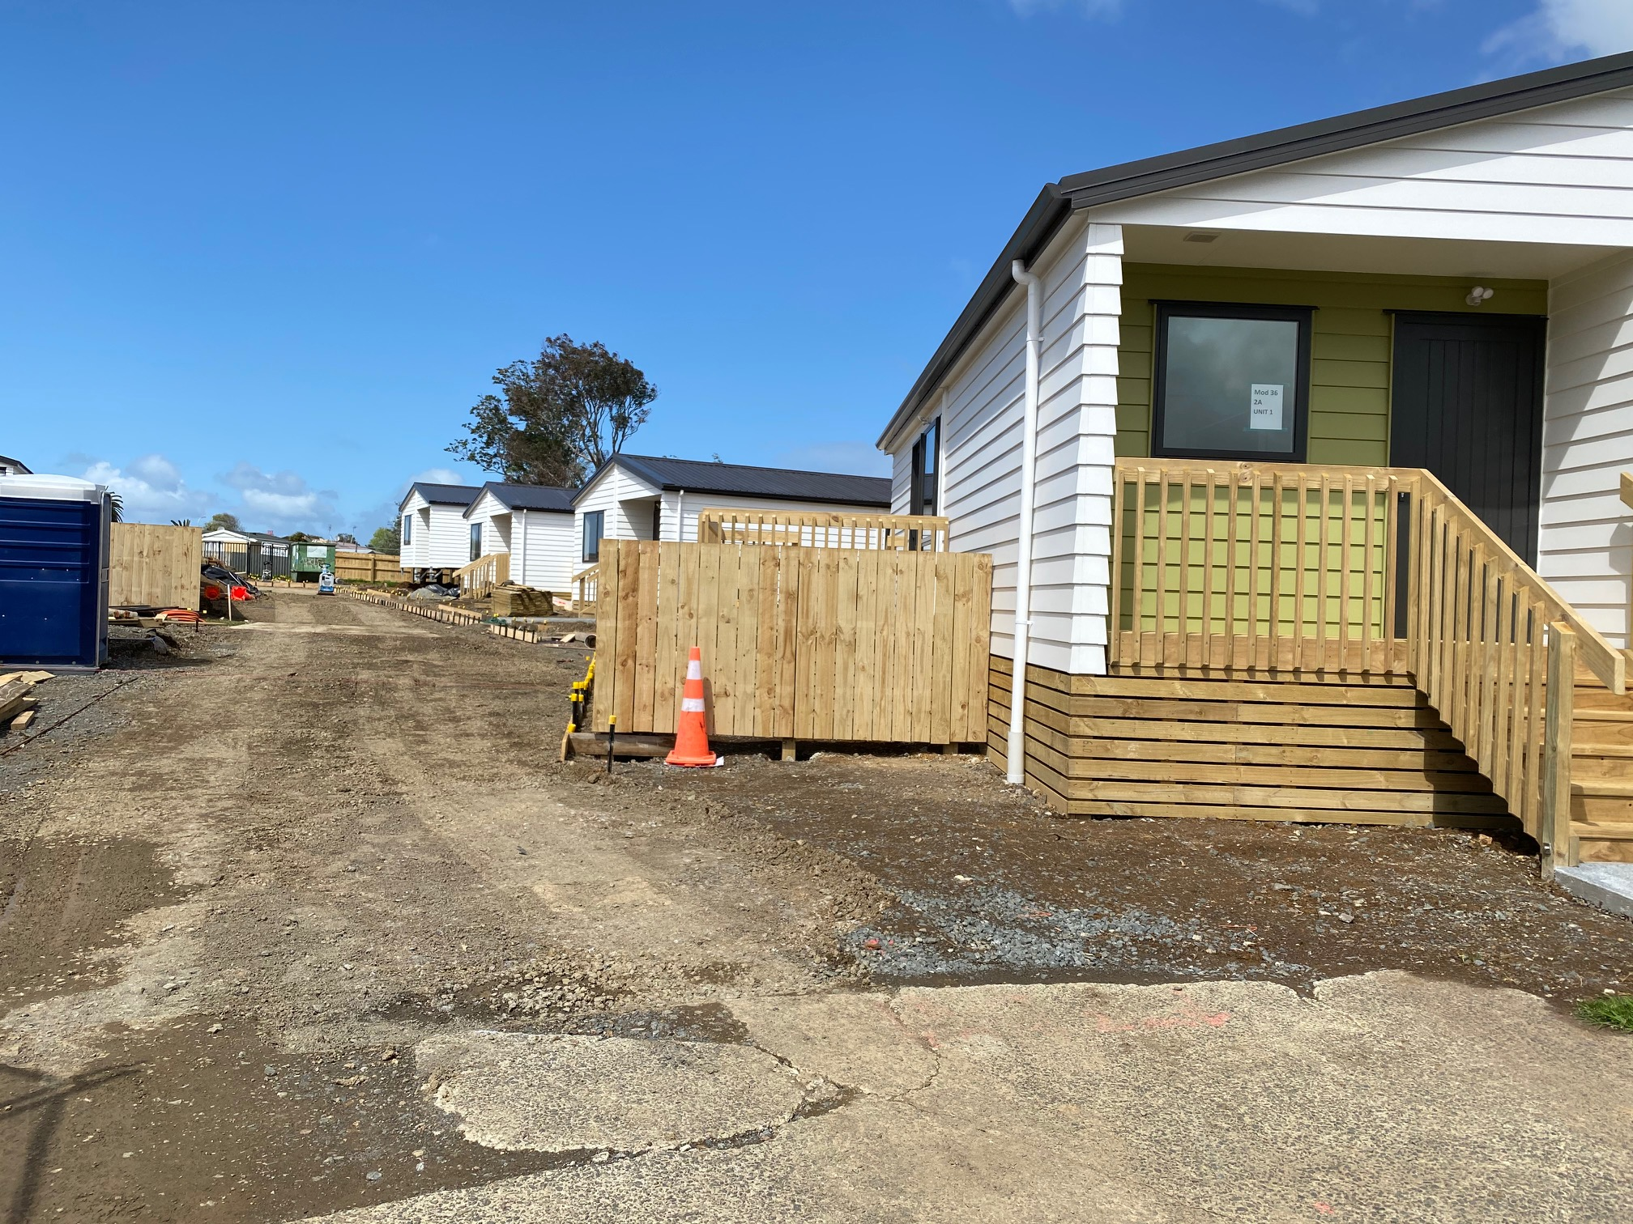

Residential Sector Solutions

Slide 29
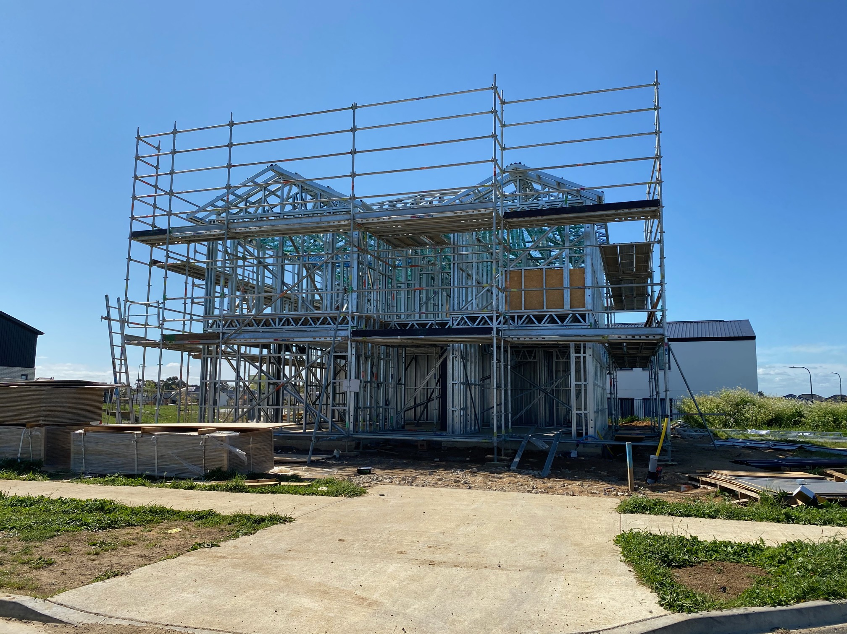
Residential Sector Solutions

Slide 30
Residential Sector Solutions
Watch this Space…..

Slide 31

Thank You

